Slide 1
Job Portal with Resume Building

Slide 2

Introduction
This project, 'Job Portal With Resume building,' is designed to transform the way job seekers connect with employers. By simplifying the application process and providing advanced management tools for recruiters, it creates an efficient, user-friendly platform to bridge the gap between talent and opportunity.

Slide 3
Send automated email notifications upon registration, ensuring users are updated with account details and platform communications.
Allow users to create professional resumes easily by inputting their details through an intuitive interface.
. Provide a dedicated page for users to connect with the team, ask questions, and get support effectively.
Provide an advanced and user-friendly search feature to help users find job opportunities tailored to their skills, location, and preferences..
Project Objective
1.
2.
3.
4.

Slide 4
User Authentication (Log In/Register)
Contact Us Page
Advanced Job Search
Resume Builder
Automated Email Notifications
Key Features

Slide 5


Slide 6
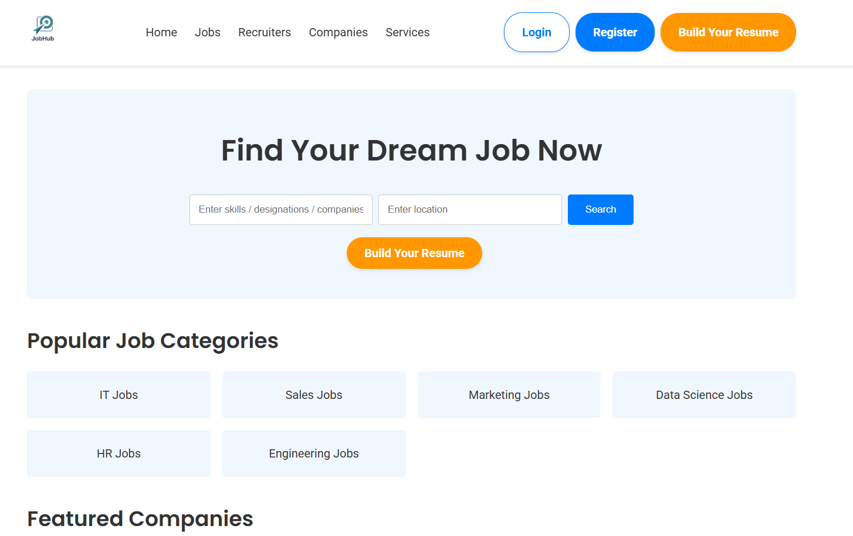
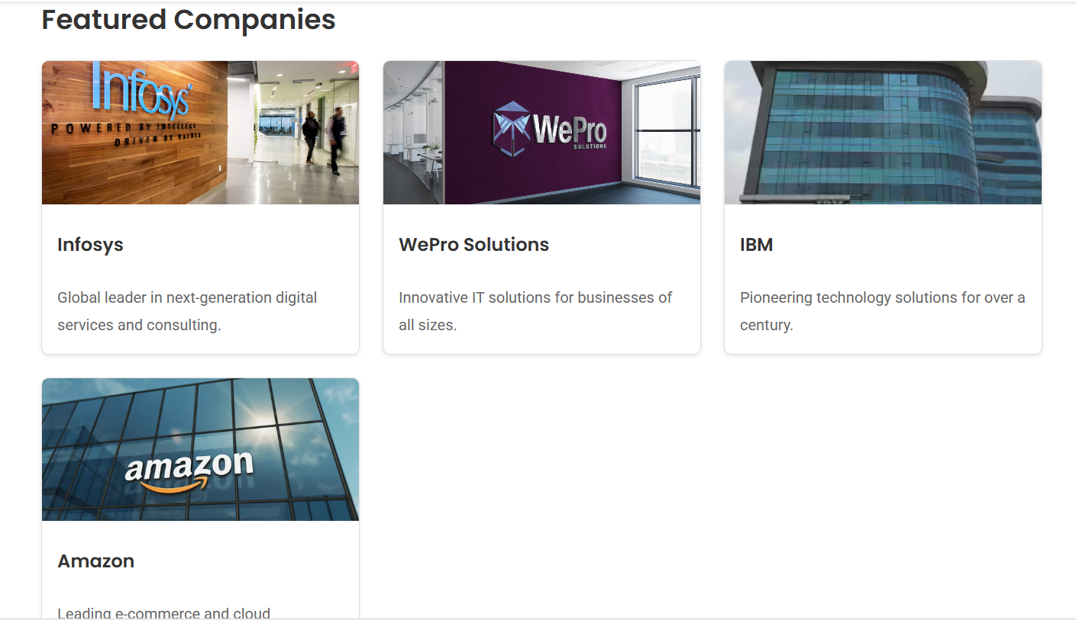
On entering the website , the user will be greeted by our homepage provides a user-friendly interface with job search, resume-building options, popular job categories, and featured companies to help users find their dream job.
Home page →

Slide 7
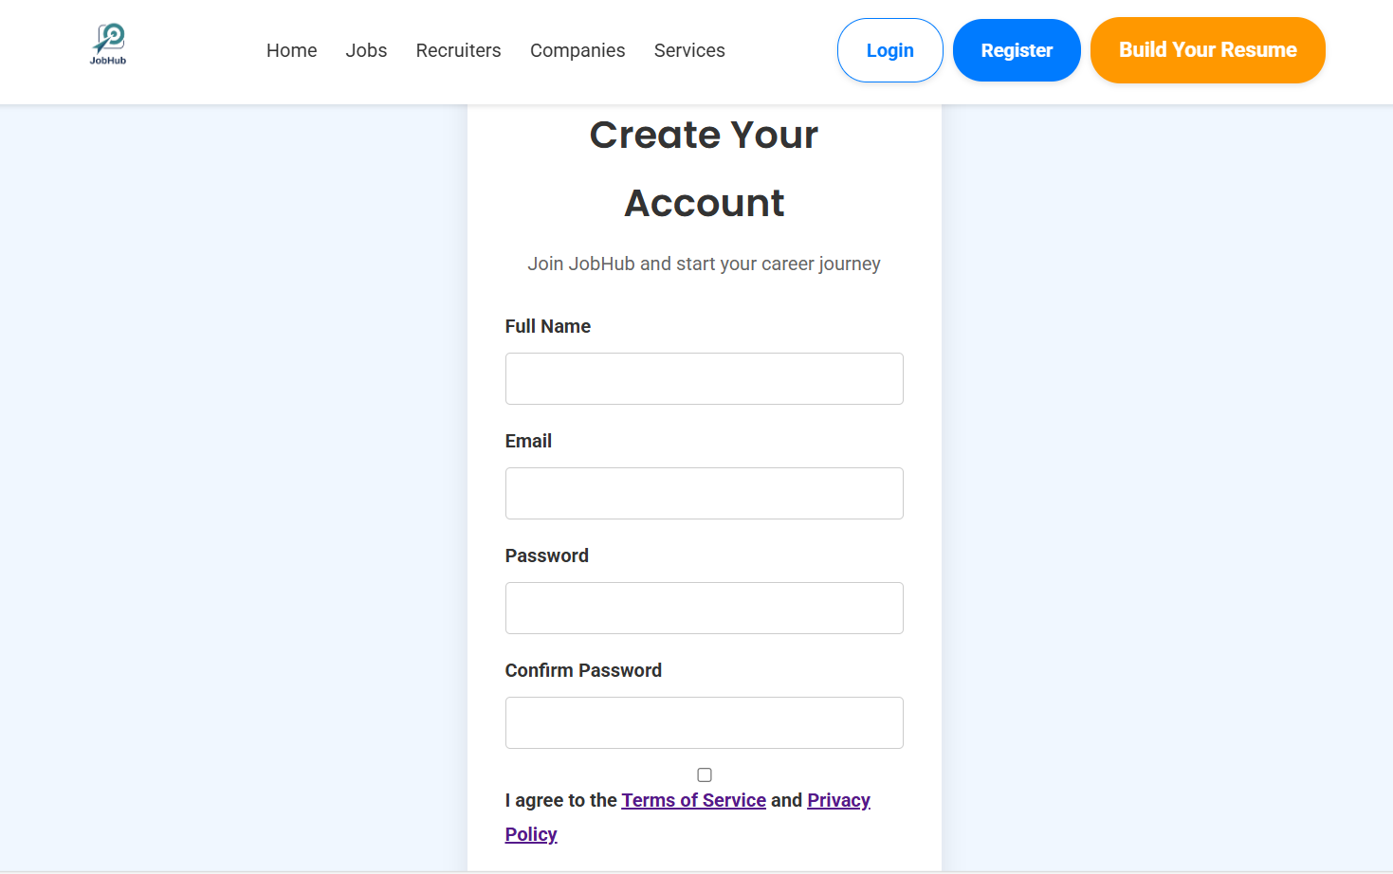
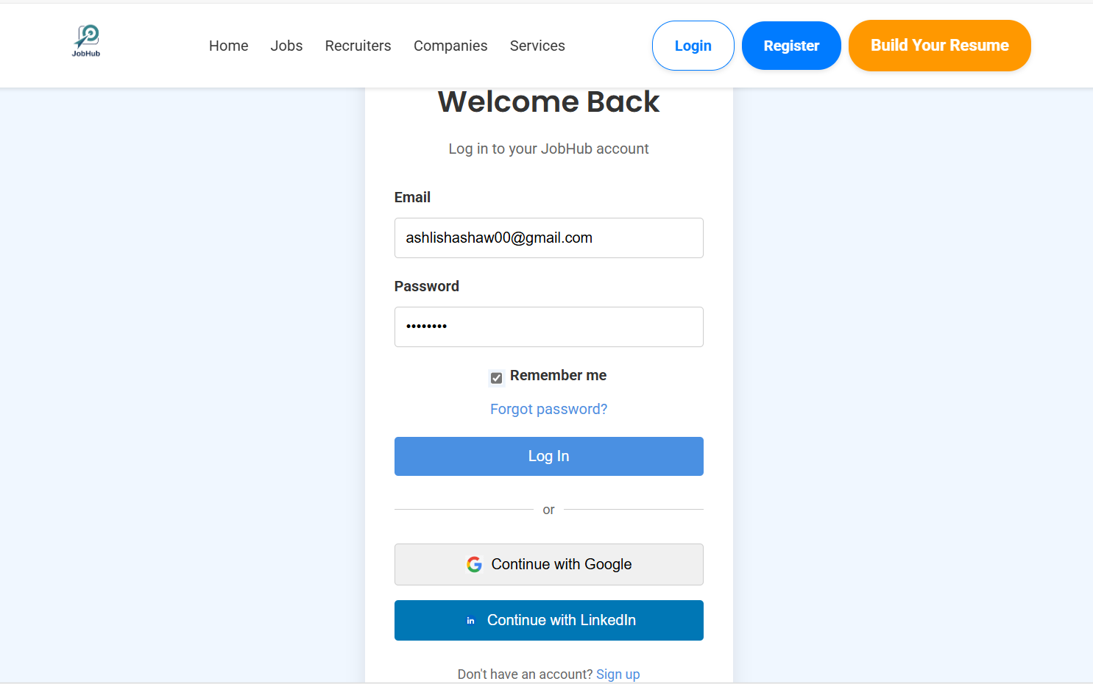
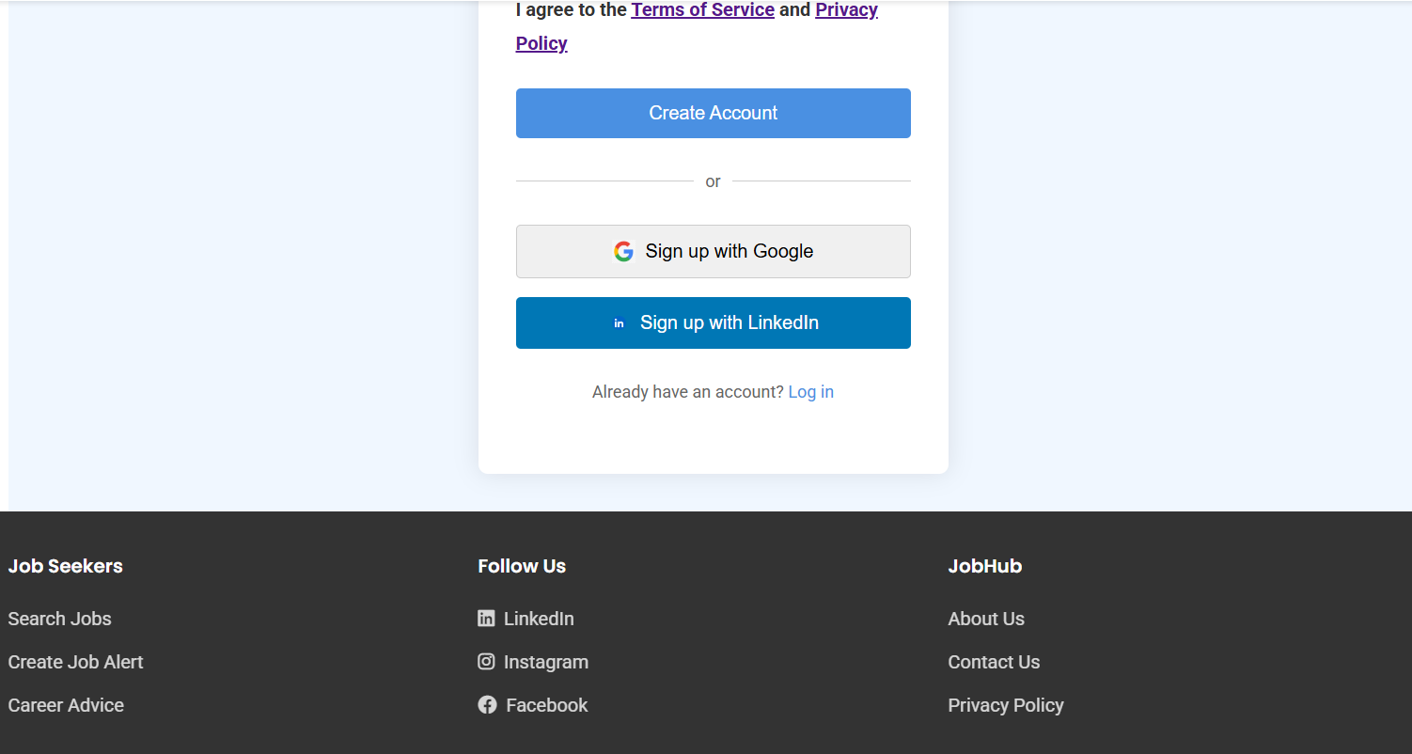
Register / login
The Register/Login page enables users to create an account or log in using their name, e-mail & creation of Password. Or user also can click on sign up with google to continue with their social media account.

Slide 8
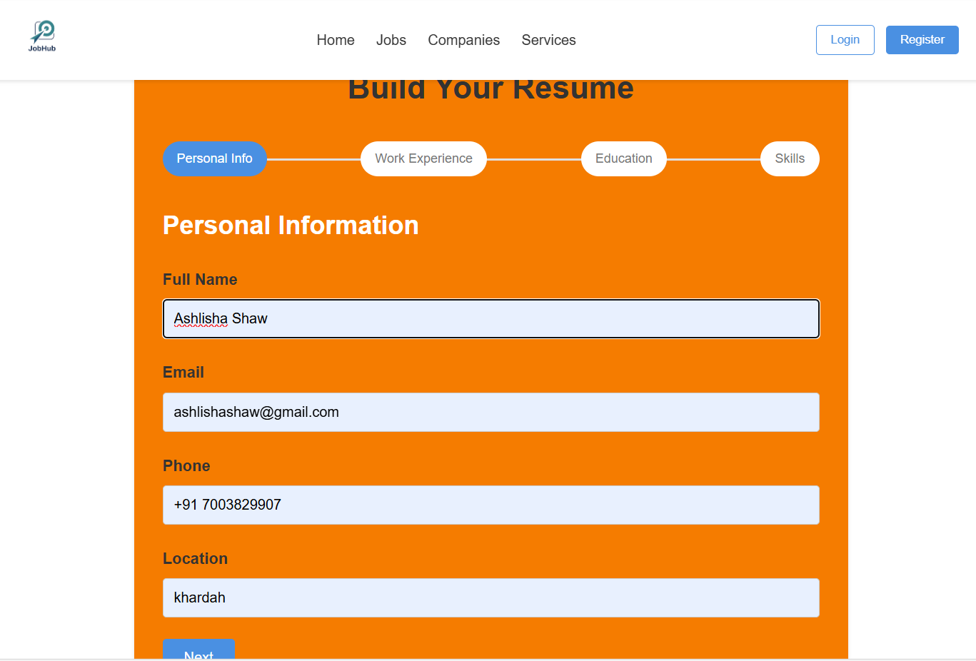
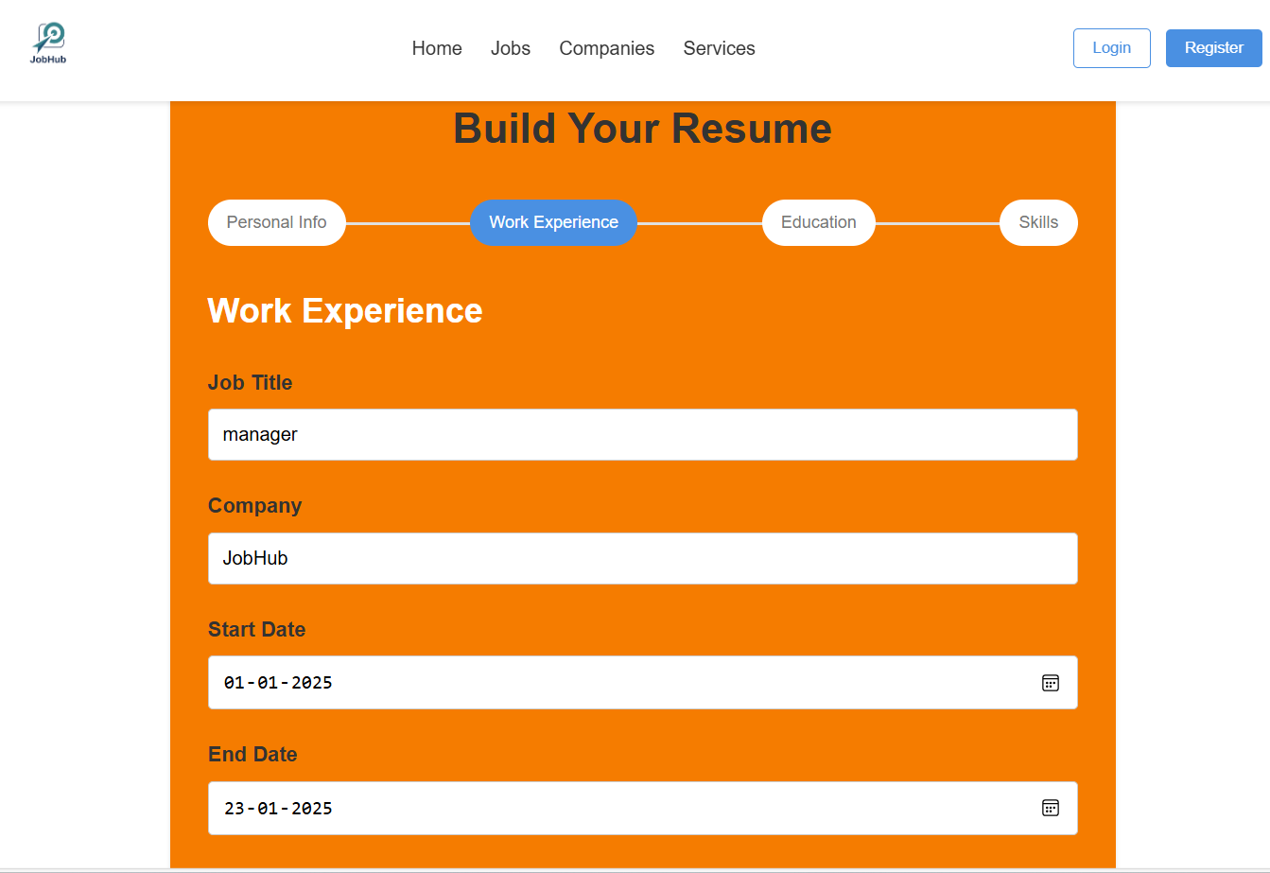
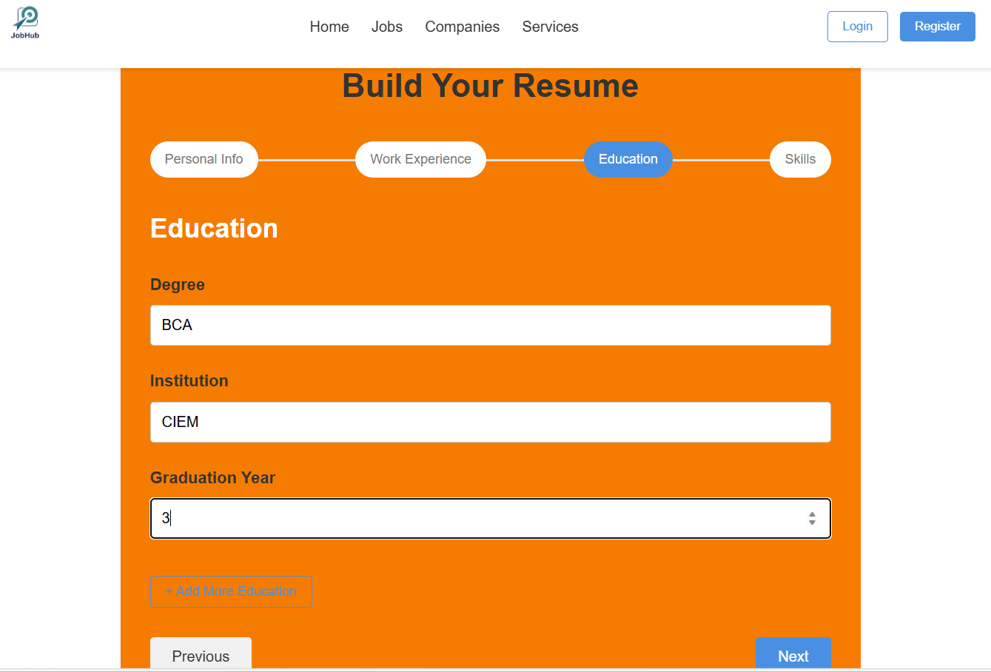
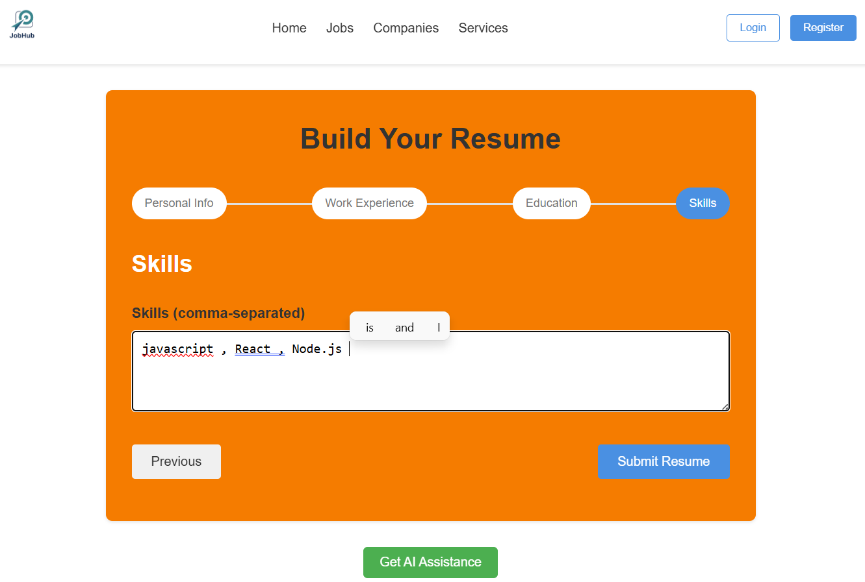
Resume builder
The Resume Builder page allows users to create professional resumes by entering their details and provides the option to download the resume in PDF format for easy sharing.

Slide 9
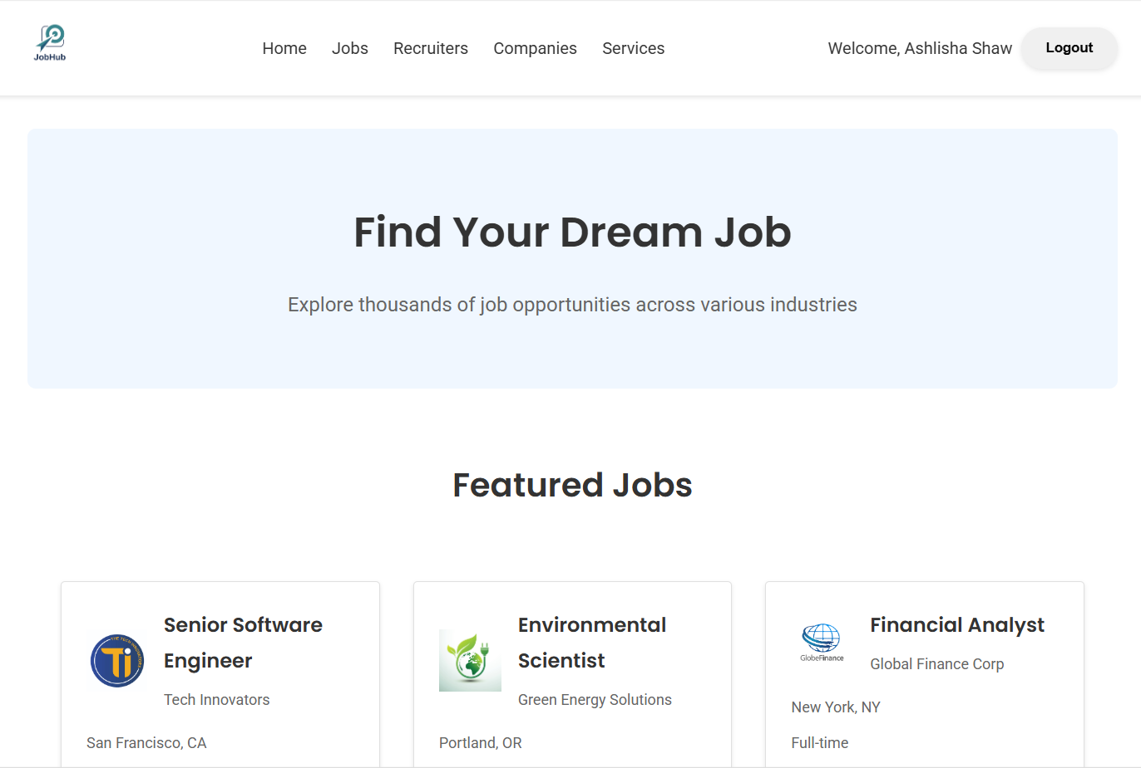
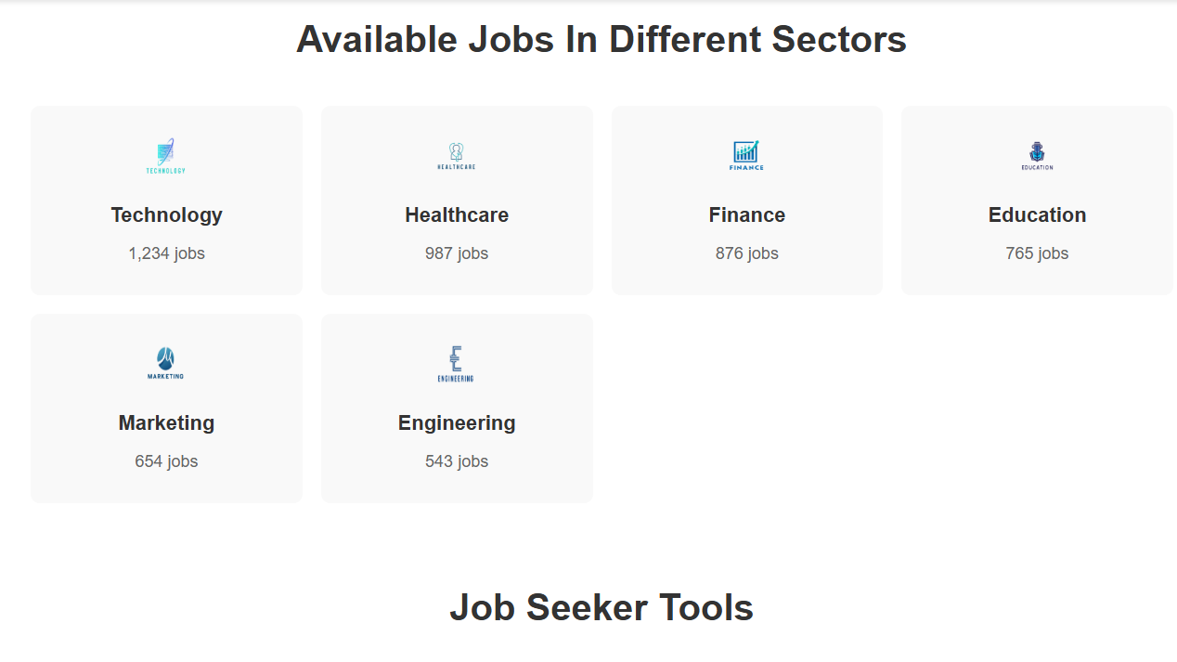
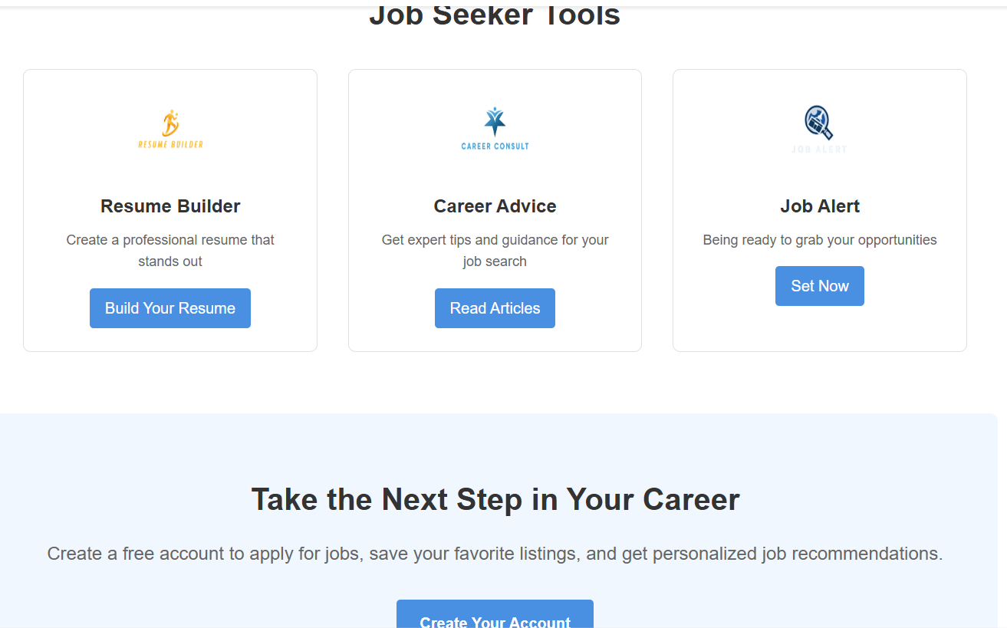
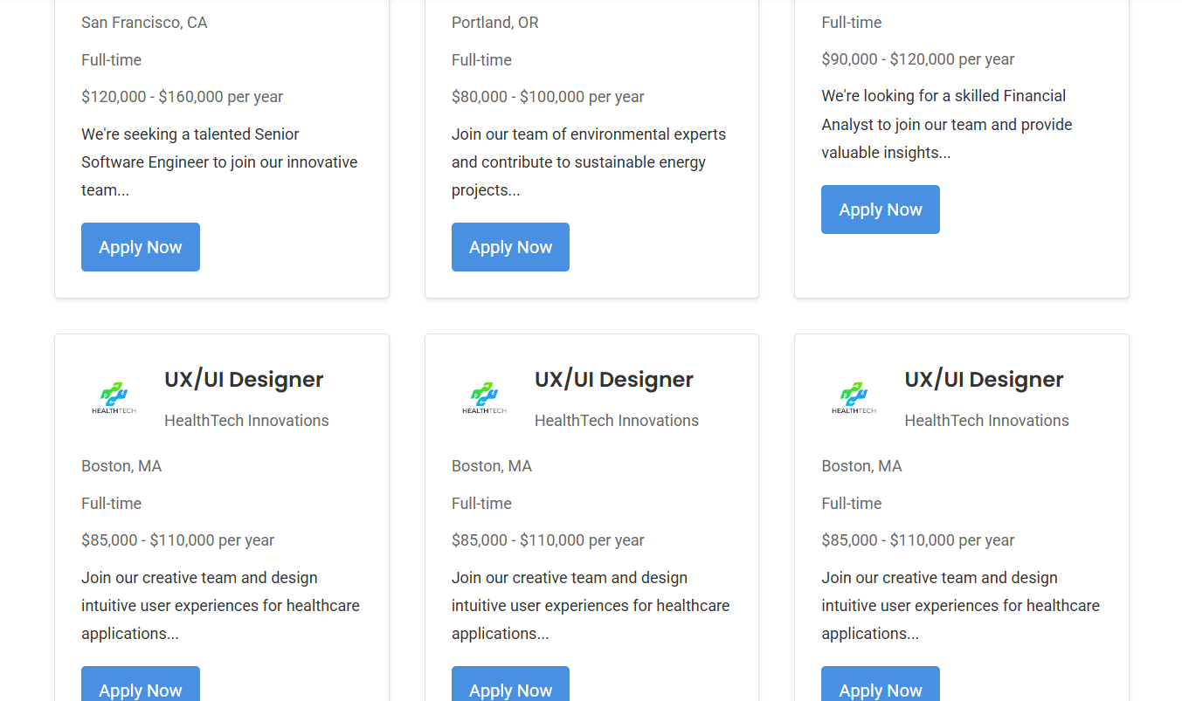
Job page
In this page user can see for available jobs in different sectors find their comfortable jobs by simply click on ‘create your account’ button.

Slide 10
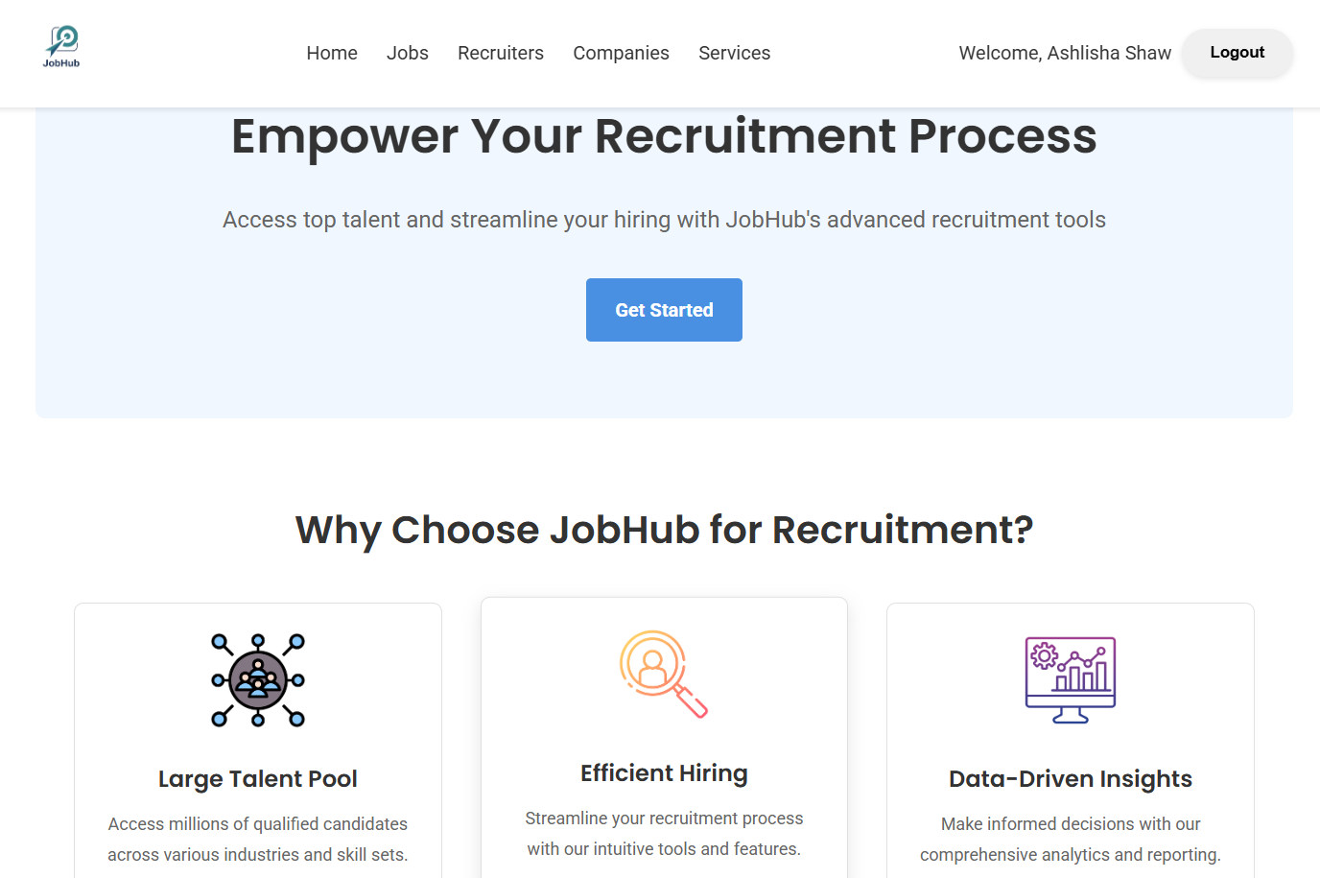
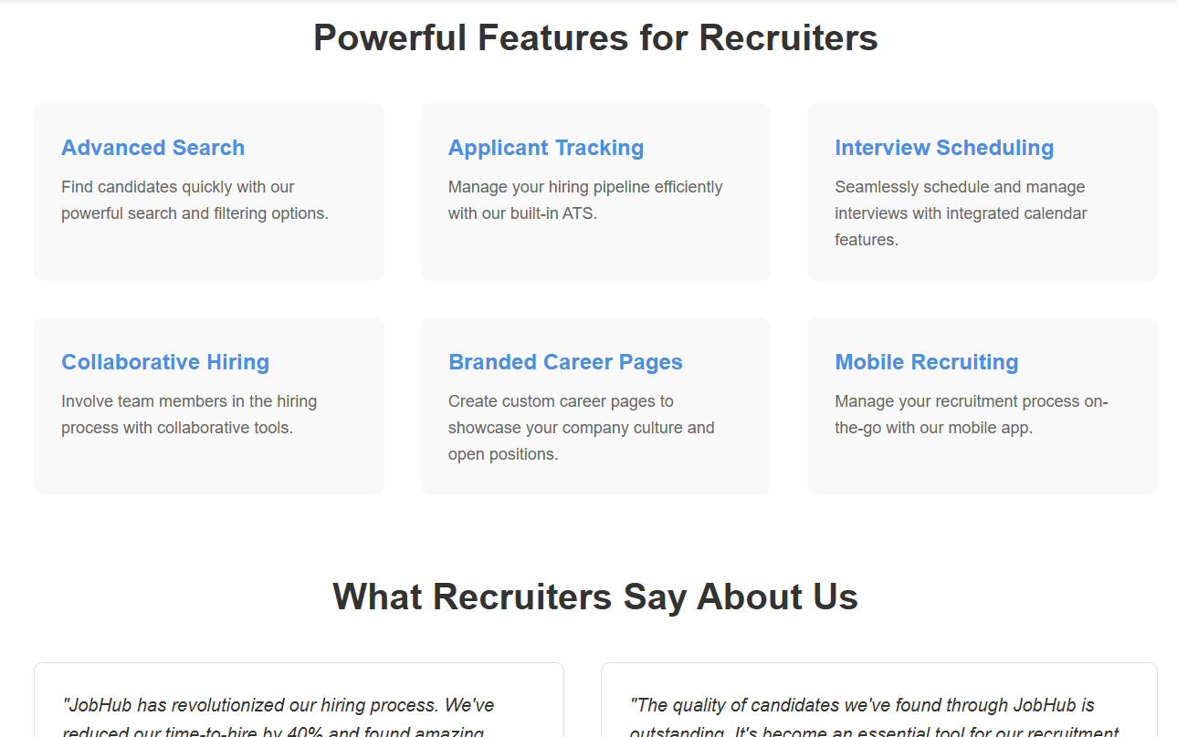
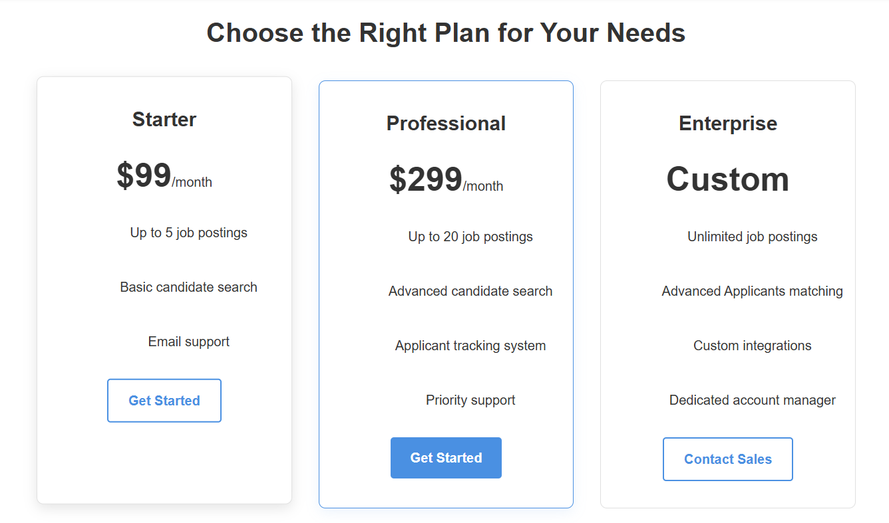
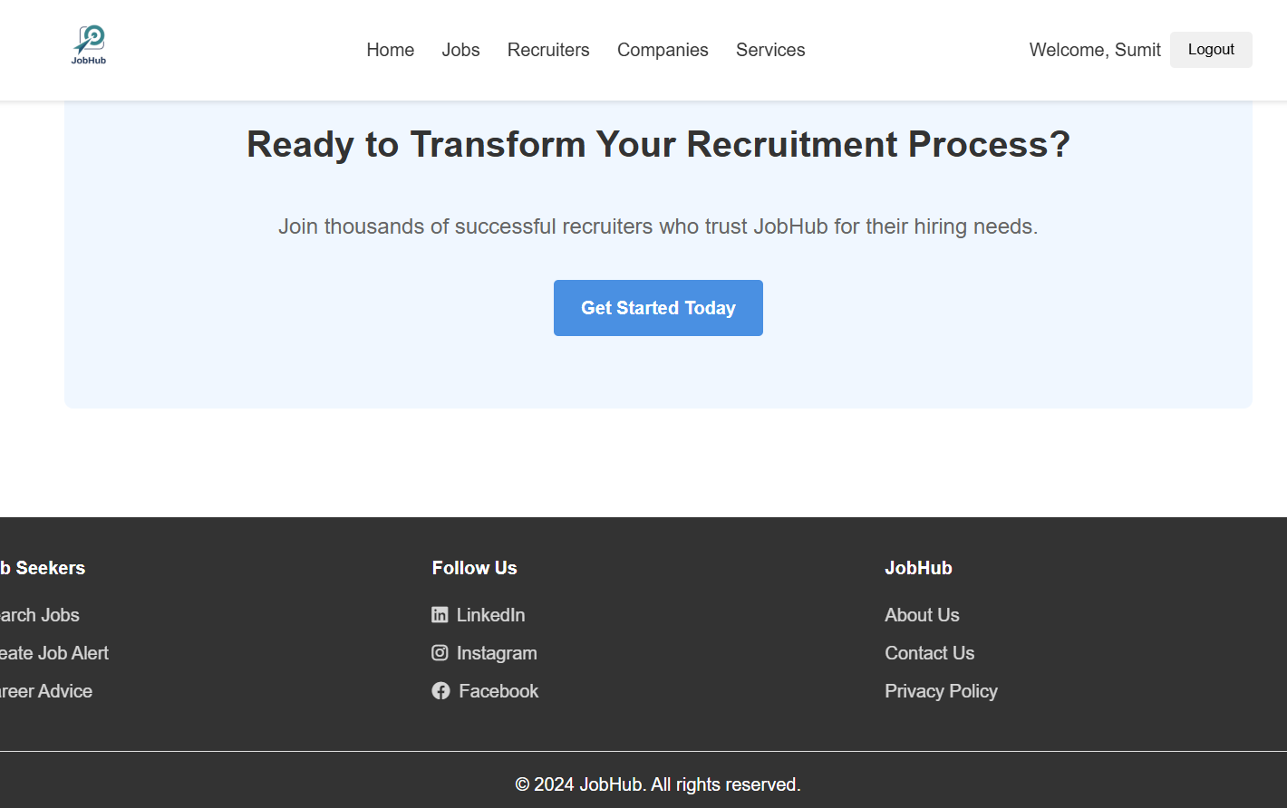
recruitment
The hiring process with an efficient and user-friendly recruitment page connecting employers with top talent.

Slide 11
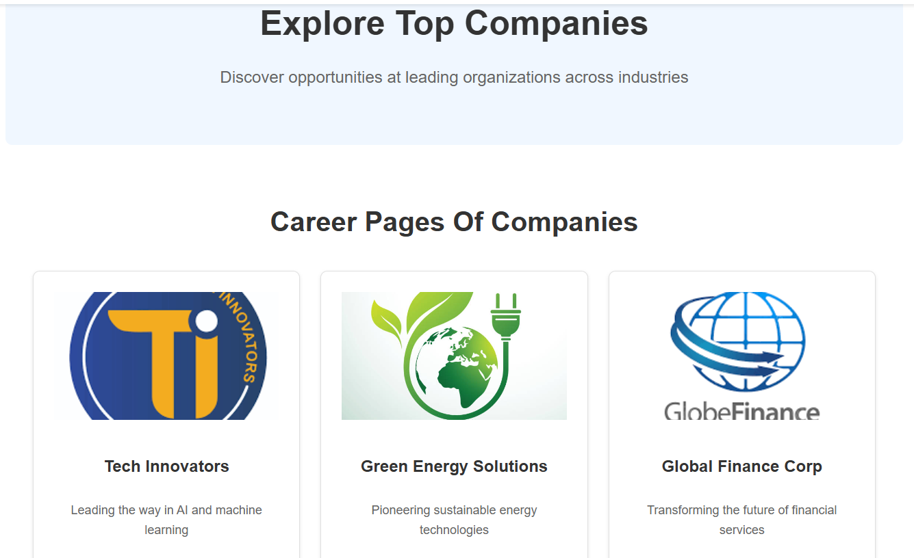
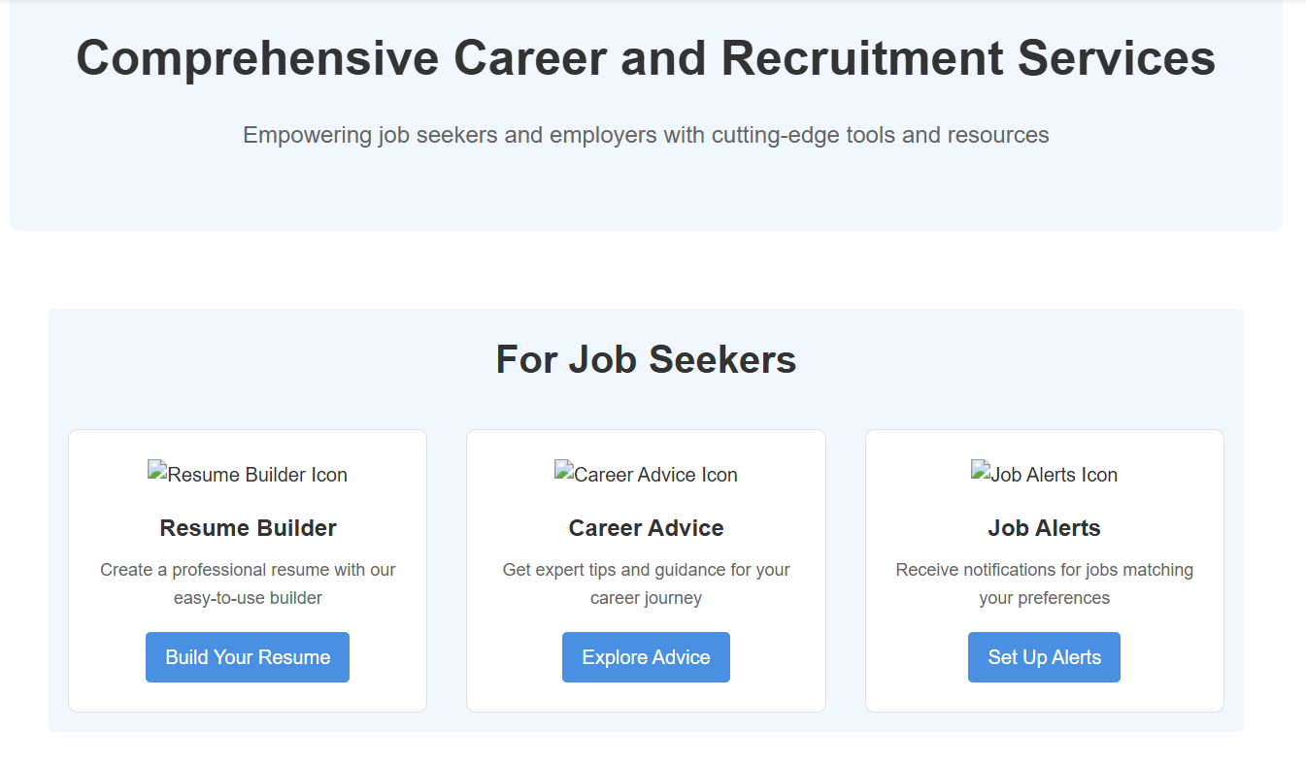
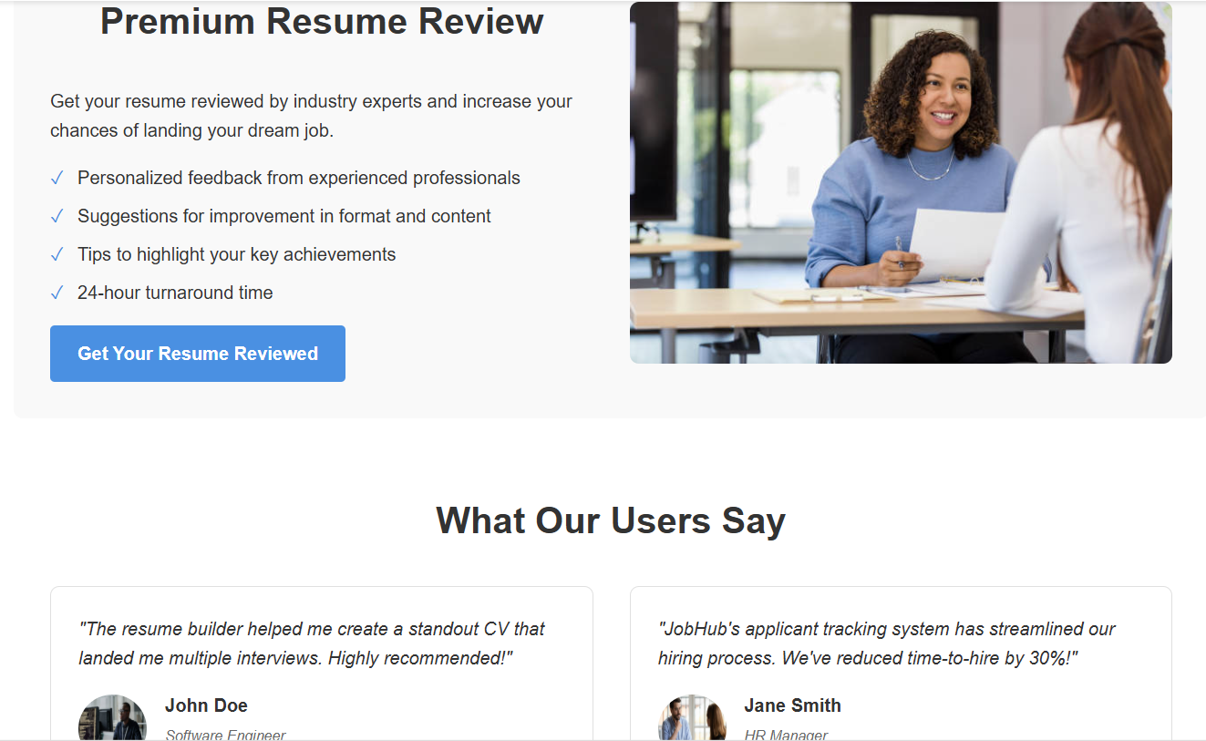
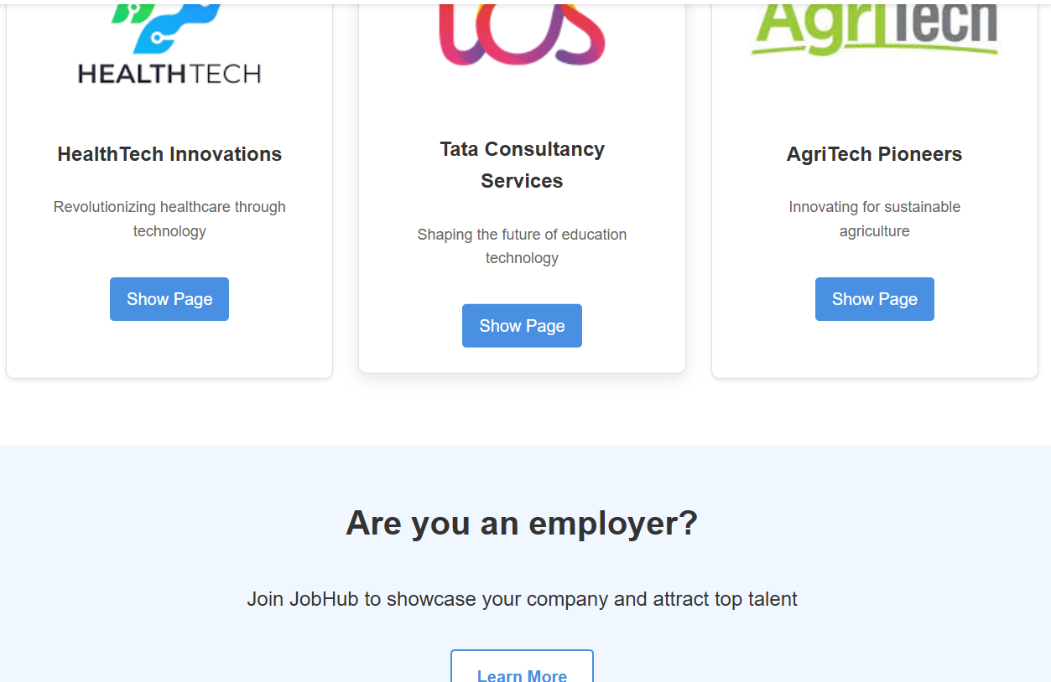
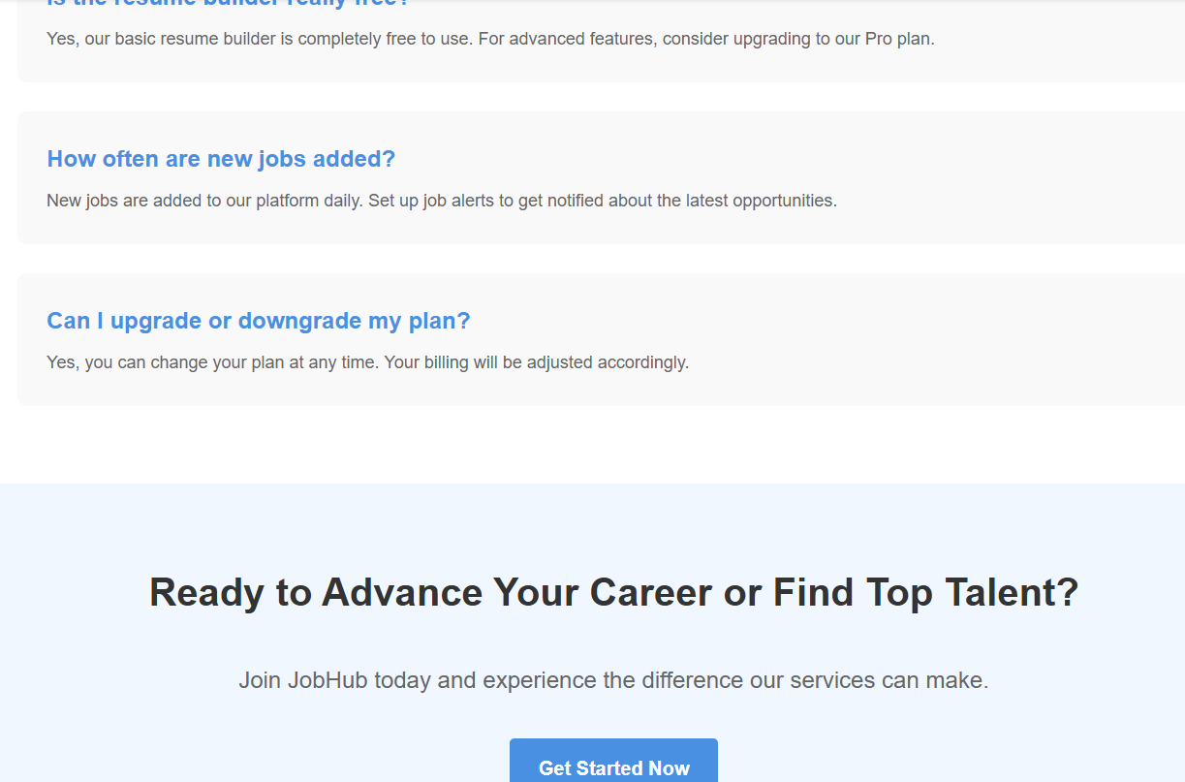
Companies/ services
The companies we are associated with to provide jobs.

Slide 12
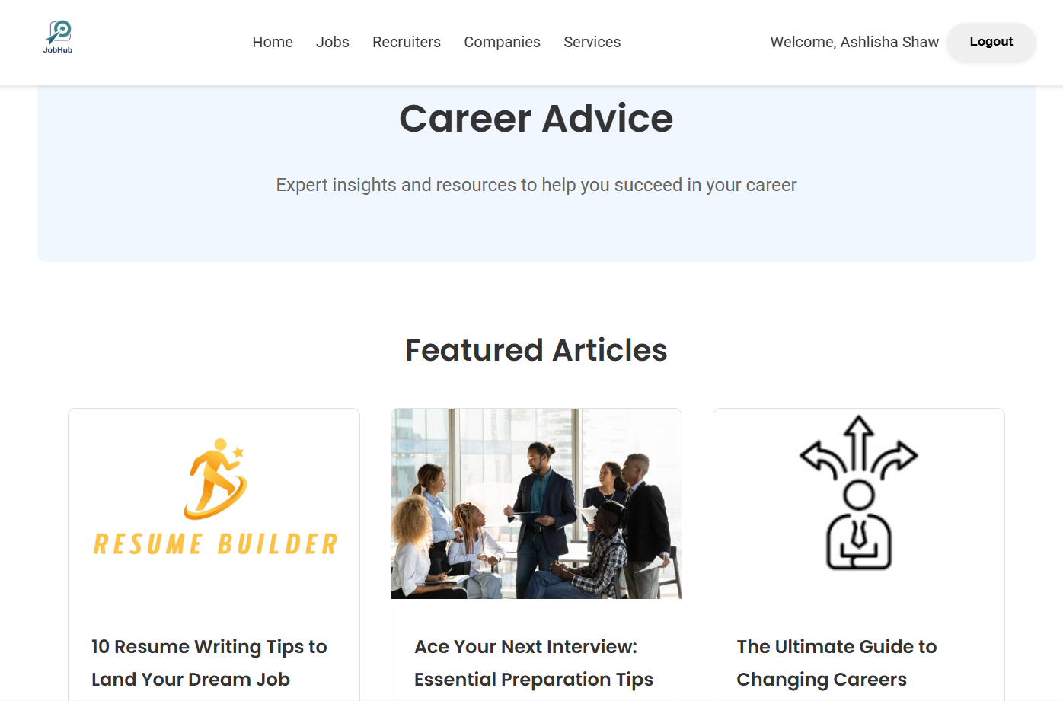
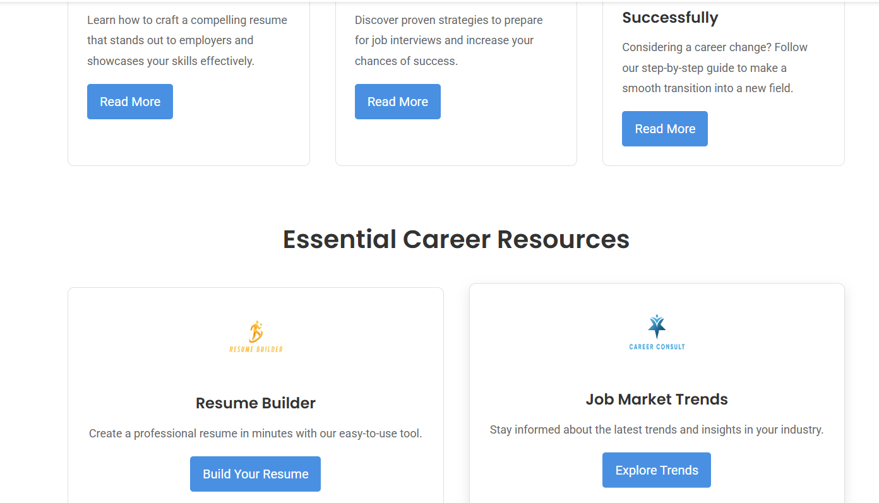
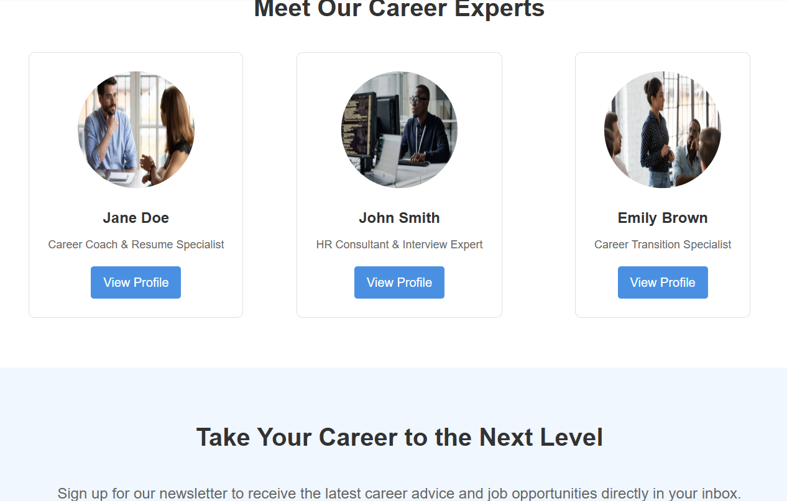
Career advice
This page will provides expert guidance and resources to support professional growth . Users can also connect with career experts for personalization advice and build their resumes using the integrated resume builder tool etc.

Slide 13
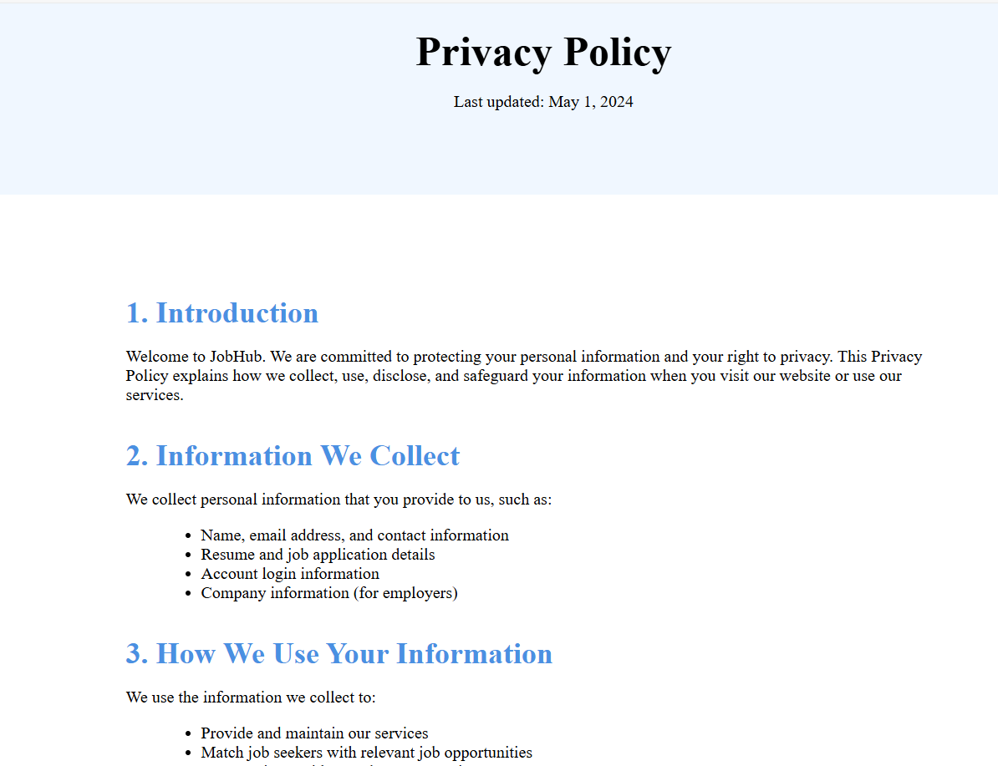
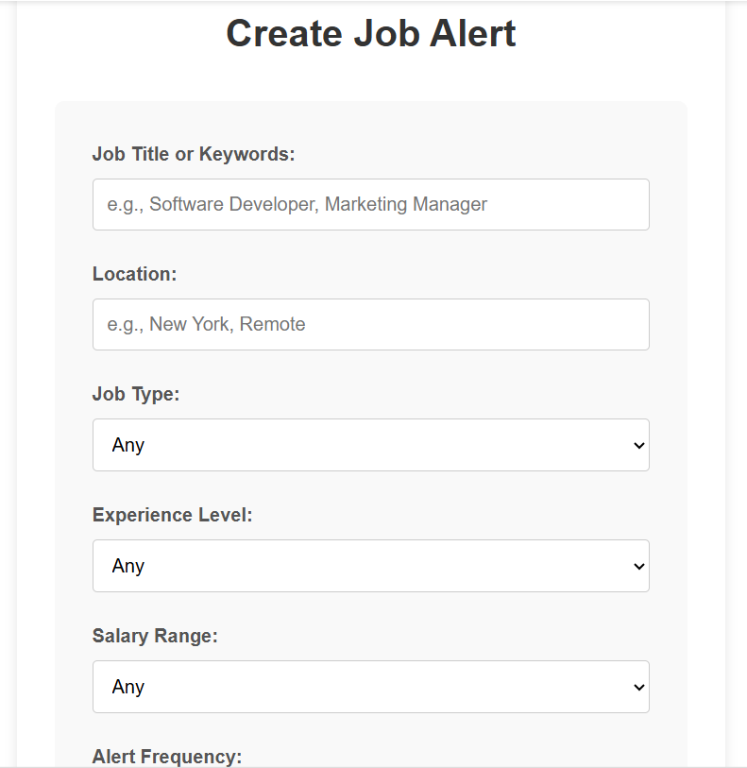
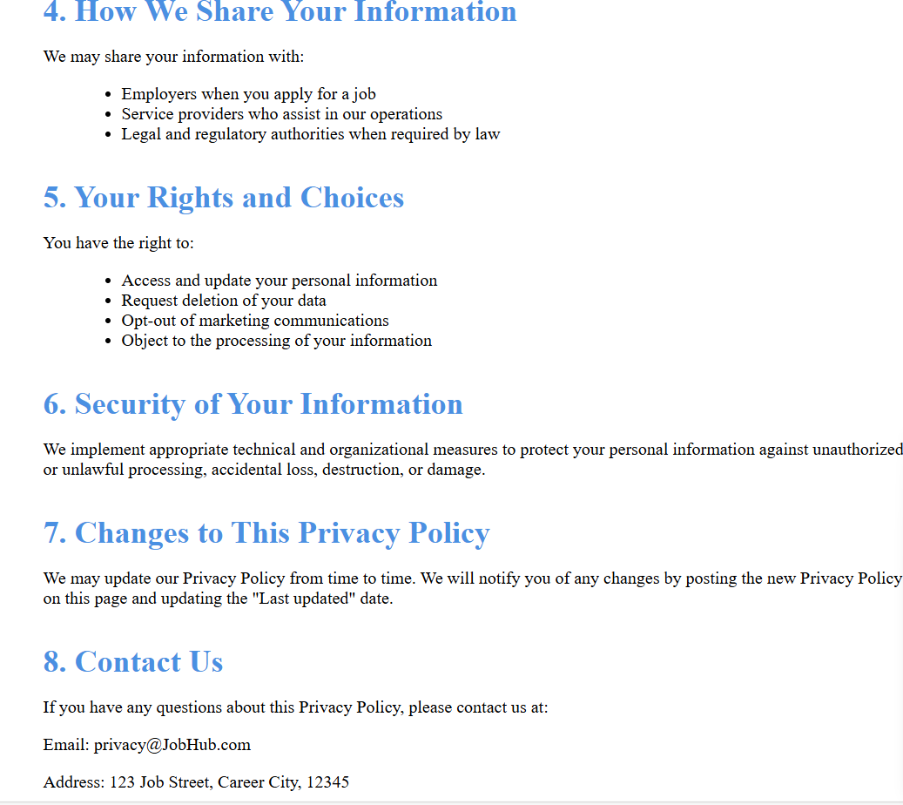
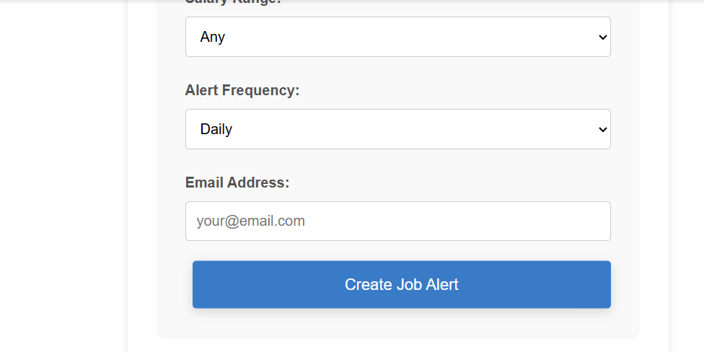
Job alert / privacy policy
This page integrates the ‘Job Alert’ feature, allowing users to create personalized job notifications by specifying key preferences such as job title , location, and frequency of alerts.
Additionally it provides a comprehensive ‘privacy policy’ outlining the collection , usage, and protection of user information to insure transparency and trust.

Slide 14
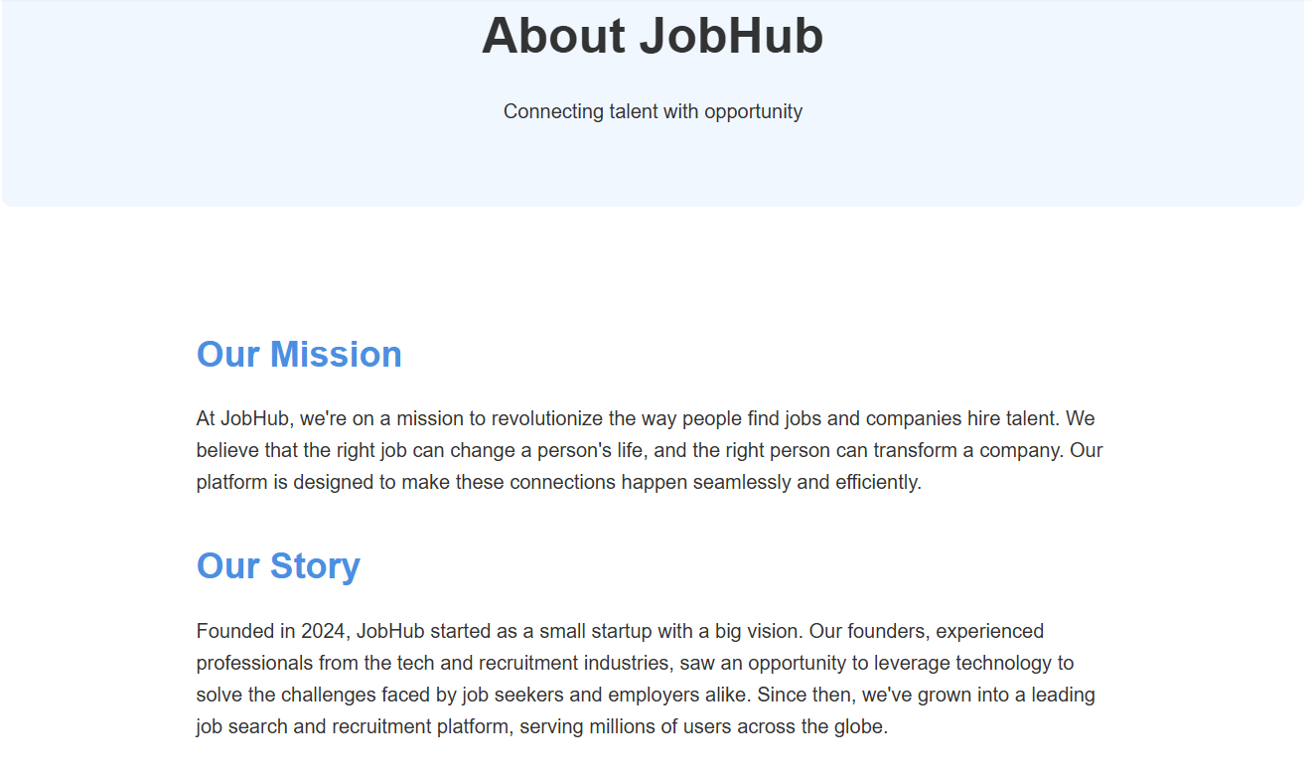
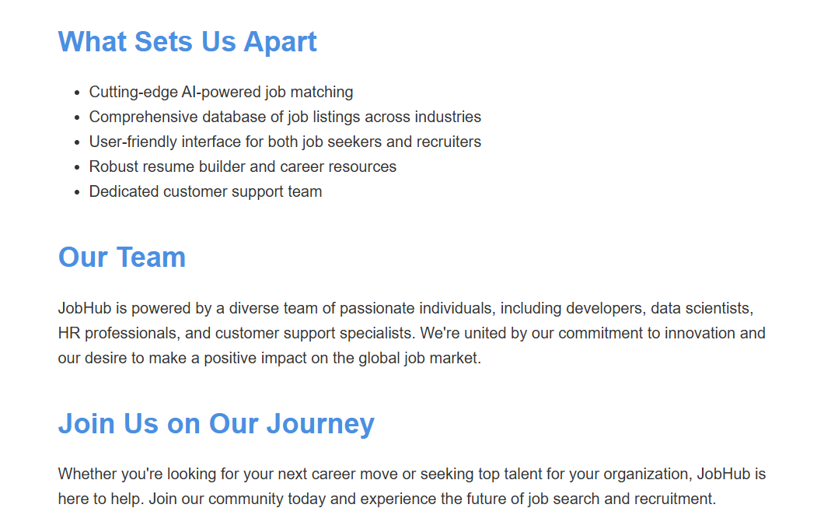
About us
Our story, journey, team members name and the mission of our site are available in this page.

Slide 15
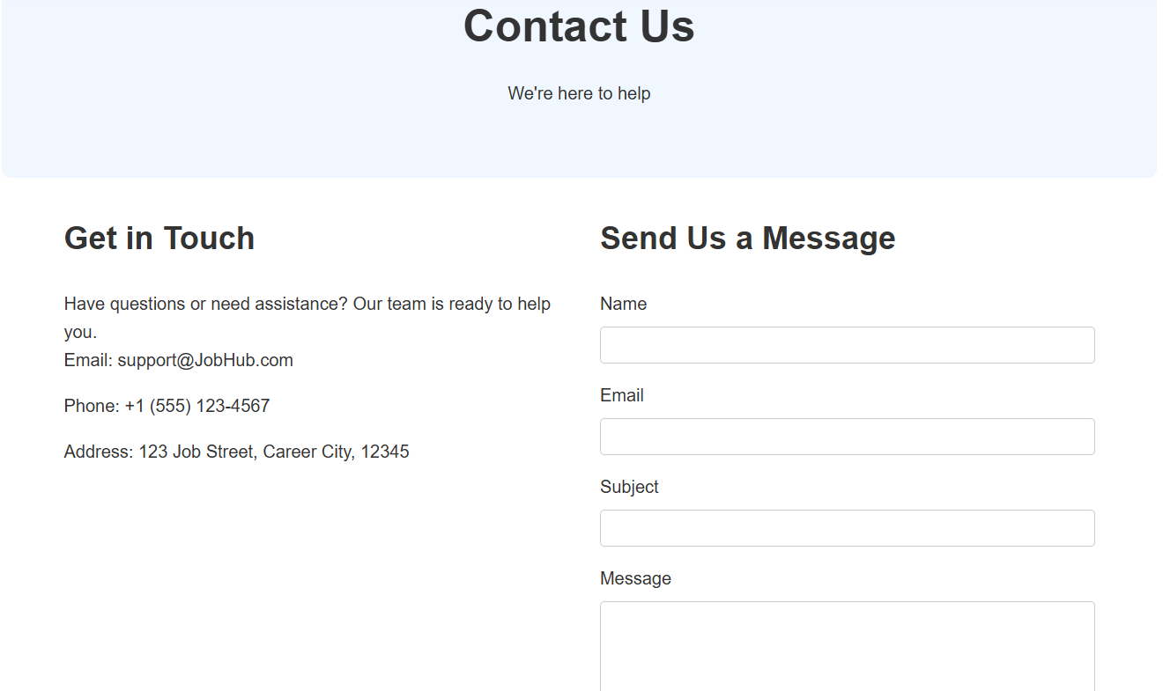
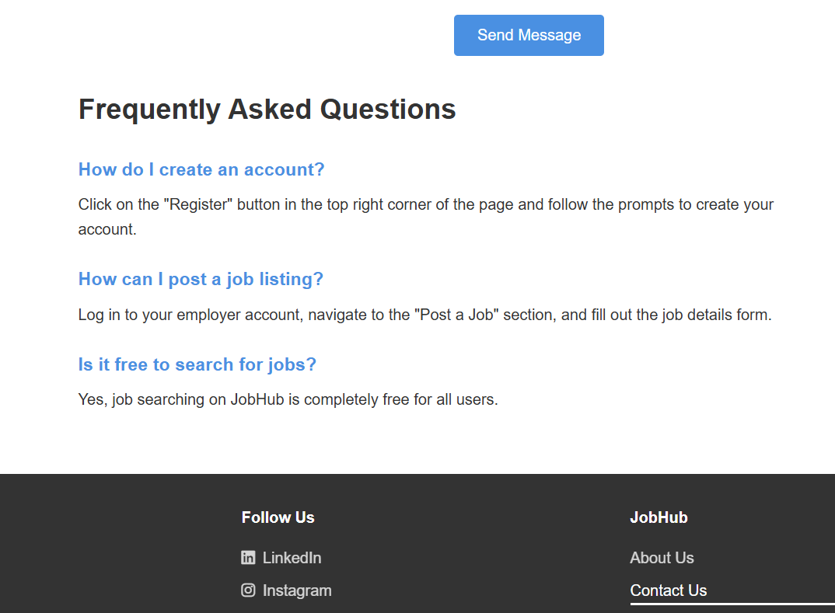
Contact us
It offers users to connect with the team for quick inquiries.
Follow us on social media for updates and supports.

Slide 16
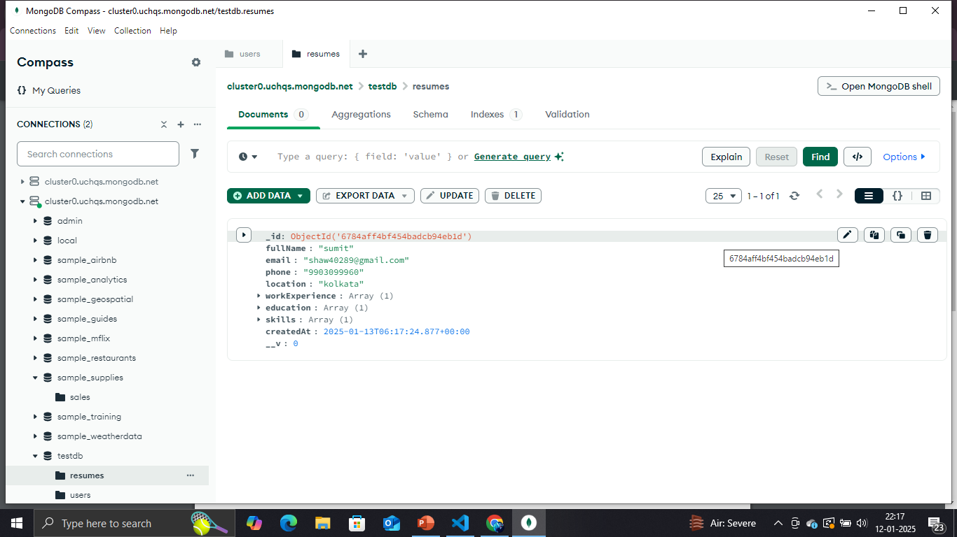
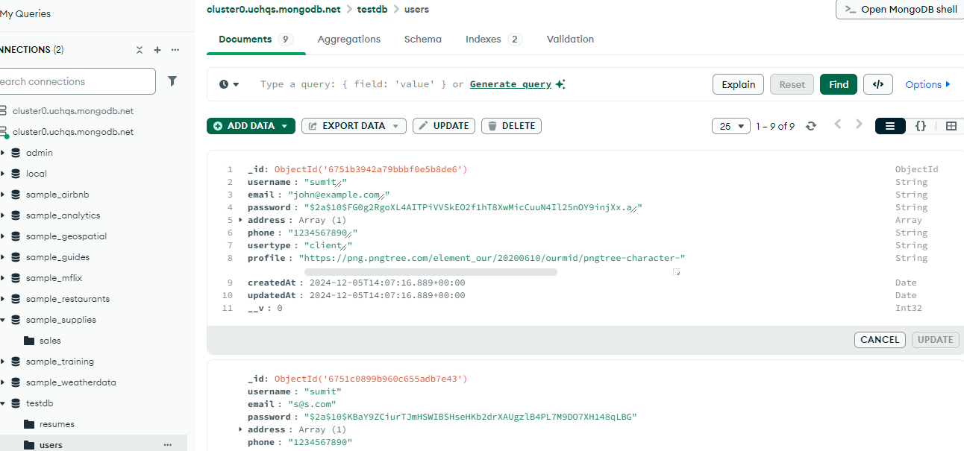
RESUME BUILD USER’S DATABASE
REGISTERED USER’S DATABASE
A database is an organized collection of data that is stored, managed, and accessed electronically. It is designed to efficiently store, retrieve, and manipulate data, ensuring that information is available and accurate when needed.
Entities.
Attributes.
Relationships.

Slide 17

A database schema is the blueprint or structure of a database.
Database Schema in Software Development:
Organizing Data
Data Integrity
Data Security
MongoDB (NoSQL):
Uses a flexible, document-oriented model where data is stored in JSON-like documents (BSON).
Ideal for unstructured or semi-structured data where schemas may evolve frequently.
You need high scalability for massive datasets.

Slide 18
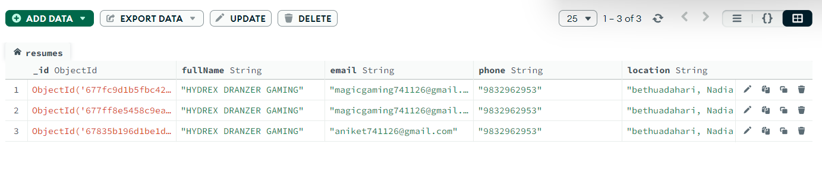
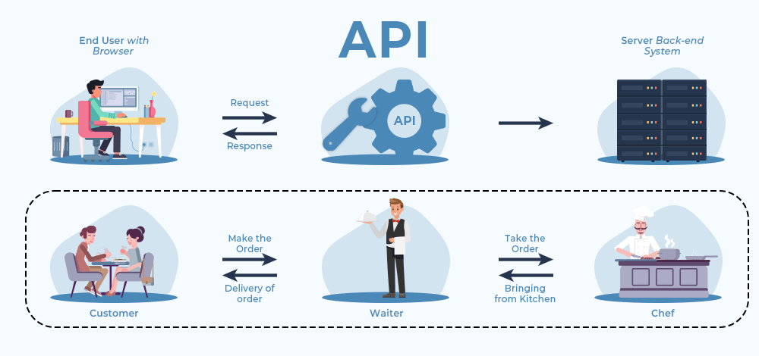
Backend Development
Technologies Used: Node.js, Express.js, MongoDB, JWT (for authentication),Html(Hypertext Markup Language).
API Development: RESTful APIs for managing users, and resumes.
Database Management: CRUD operations for user and job data.
Email Integration: Automated notifications for user actions (e.g., registration).
Payment Simulation: Frontend alert confirms payment for recruiter plans.

Slide 19
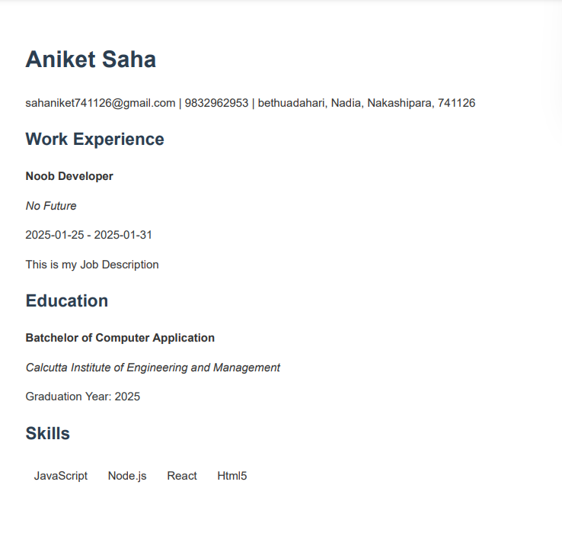
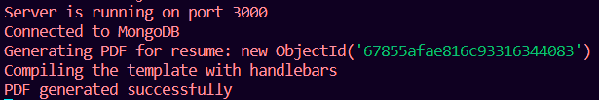
Testing and Quality Assurance
Functional Testing:
Verified job search, resume builder, and payment simulation.
API Testing:
Ensured proper request-response cycles using tools like Postman.
Database Testing:
Checked CRUD operations for consistency.
User Authentication Testing:
Tested secure login and registration flow.
Load and Error Testing:
Simulated multiple users and handled invalid inputs.
Email Integration:
Email system sends automated responses.

Slide 20
Conclusion
The Job Portal System streamlines job searching and recruitment with advanced features like job search, resume building, and email notifications. Future enhancements, including AI tools and admin panels, ensure continuous improvement. This platform is a step toward revolutionizing the hiring process for all users.

Slide 21
AI-Powered Resume Assistant
Enhanced Email Functionality
Data Analytics Dashboard
Admin Panel Development
Job Alerts and Notifications
Dark Mode Option
Future Enhancements

Slide 22
Thank you

